Slide 1
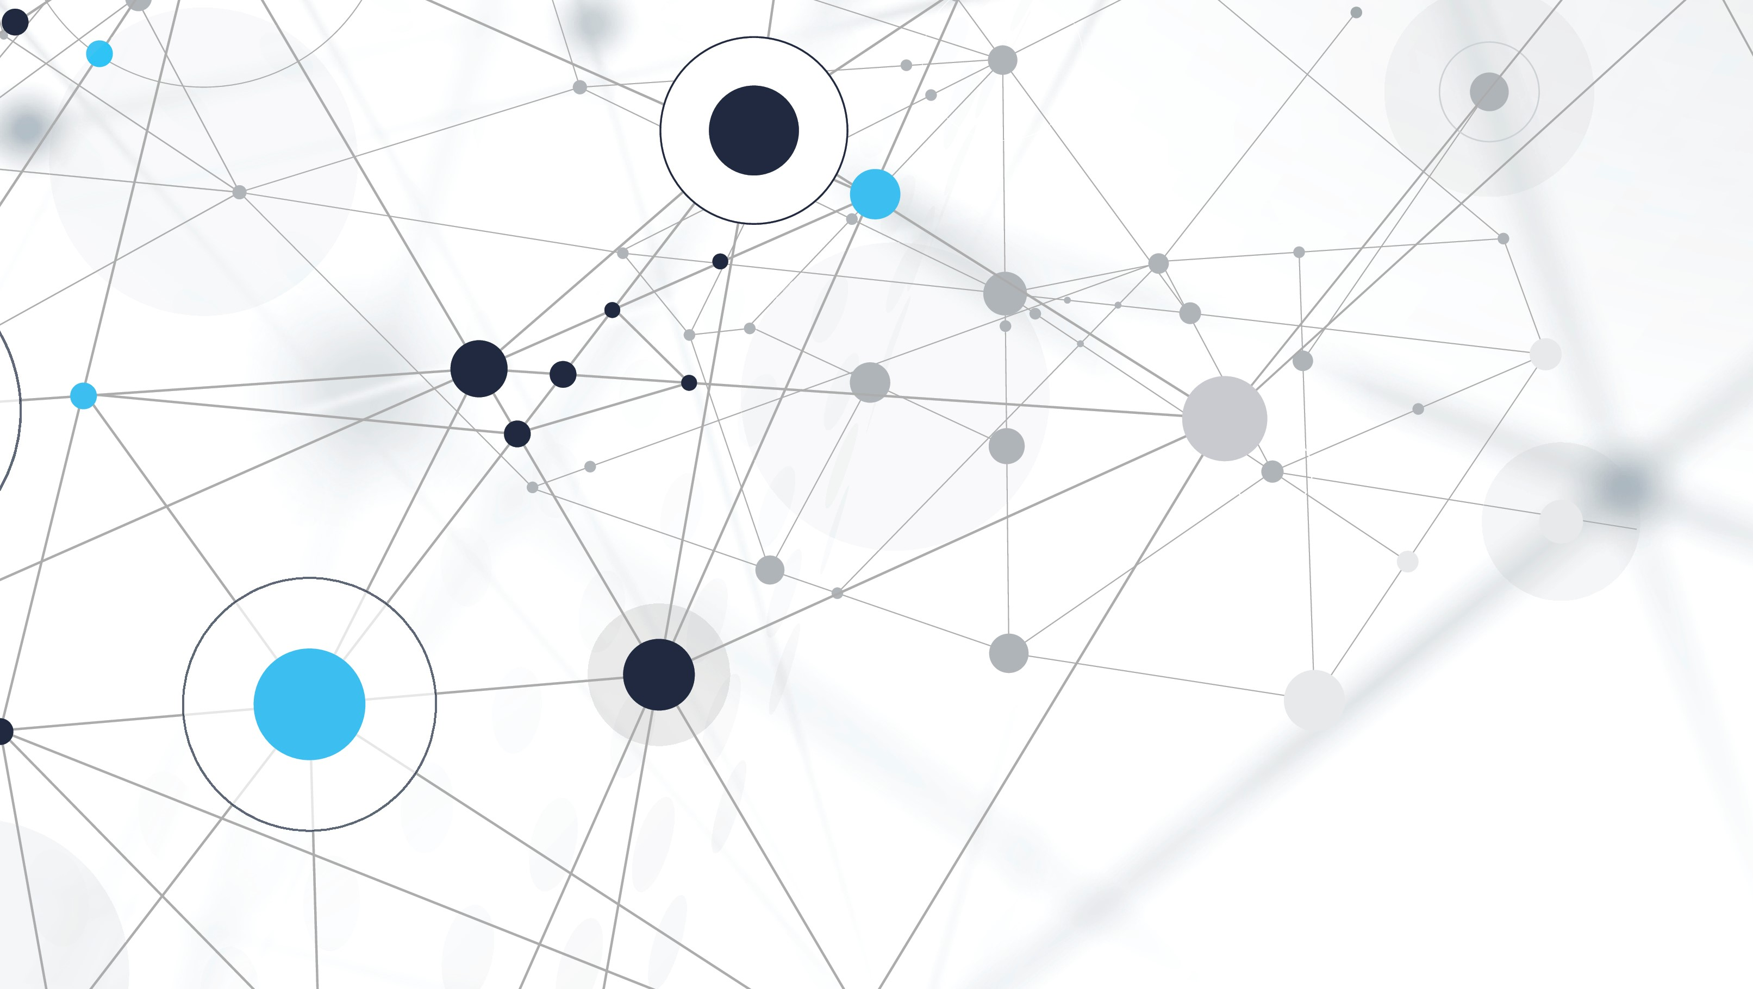
Sprint Review and Retrospective
Nick Markel

Slide 2
Explain the various roles on a Scrum-agile Team
Product Owner: First line of defense to client and outlines standards
Scrum Master: Knowledgeable of the Scrum process and facilitates stand-ups.
Developer: Dissects standards and creates solutions to the client's problems.
Tester: Tests developers’ solutions and provides feedback to the team for improvements.

Slide 3
Explain how the various phases of the SDLC work in an agile approach
Requirements Gathering:
The product owner creates the product backlog to outline requirements.
Software Design:
The team goes over design in the sprint planning meeting with the scrum master, developer, and tester.
Software Development:
Developers create solutions and present their work in daily stand-ups.
Test and Integration:
Testers provide feedback to developers in daily standups and integrate feedback into the project.
Deployment:
Entire team conducts sprint review after product ships.
Operationalization and Maintenance:
Team continues agile practices after deployment with each issue that arises.

Slide 4
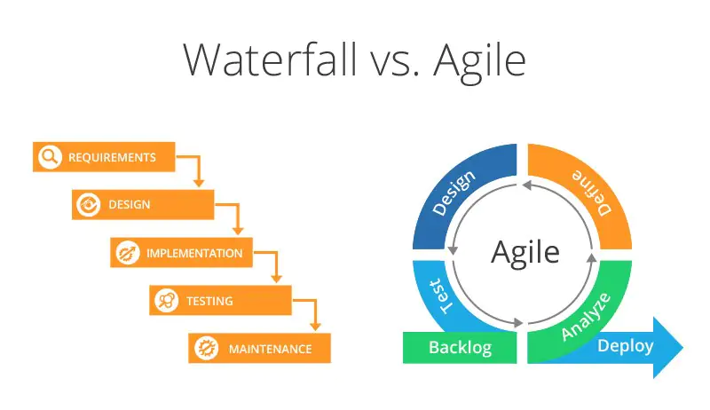
Describe how the process would have been different with a waterfall development approach
The most prevalent issue that would have been noticed in the project is when there were changes to be addressed. In agile, it was a quick communication and addition to the Kanban graphic during a daily stand-up. The development team was able to digest the change and push it very quickly. In the waterfall method, this would have halted project workflow while the development team added in the new requirement and could have extended the project due date.
Notes:
Reddy, Niveditha. “Waterfall vs. Agile Project Management: Which One Is Better for Your Business?” Digite, 23 May 2022, https://www.digite.com/blog/waterfall-vs-agile-project-management.

Slide 5
Explain what factors you would consider when choosing a waterfall approach or an agile approach
When faced with a project, if there was a clear-cut process in place to accomplish the said project, the waterfall method would work the best. This would be possible if there was a repeat project being accomplished or something with step-by-step directions.
Agile works for creative thinking. When a team is faced with a solution that they need to find an answer to, the agile approach flourishes. This can be contributed to the ever-improving mindset agile promotes.

